Slide 1
STAT 512: Presentation
Elliott Shi, Olivia Harper, Lyndsey Harris, Rahmi Azzahra – Group 2

Slide 2
Overview
Background
Research Questions
Data Source
Hypothesis and Variables
Methodology
Results
Discussion

Slide 3
background
Due to the recent increases in housing prices over the last decade, we want to investigate housing prices in the UK based on various factors.
We narrowed the scope of our analysis to the UK wanting to investigate whether prices might differ based on country region

Slide 4
Research questions
(Each question answered using a separate adjusted model)
Elliott: Does property characteristics given constructed year, number of rooms, and consumer's decision to buy, impact house price in the UK?
Lyndsey: Do connectivity characteristics impact house price in the UK?
Olivia: Do location characteristics (crime rate and legal cases) and region impact house prices in the UK?
Rahmi: Do salary, monthly expenses, and EMI burden, significantly predict the price of houses in the United Kingdom (the UK)?
Overall Combined Model: How do city level differences shape the impact of satisfaction score, property size, and EMI to income ratio effect housing prices in the UK?

Slide 5
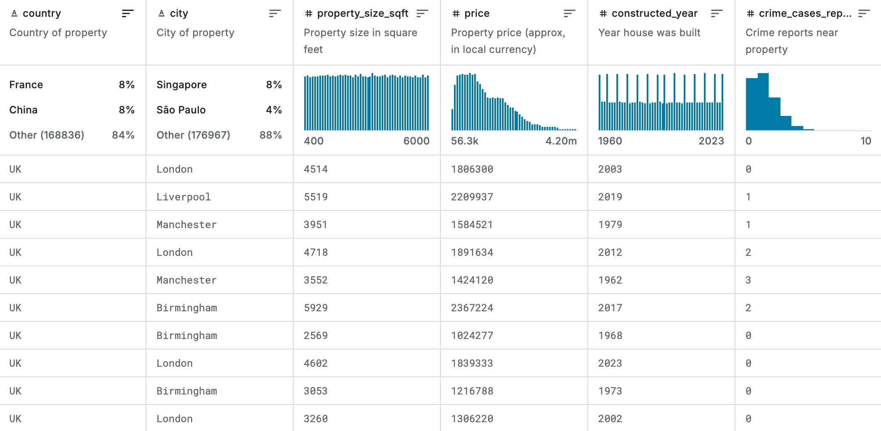
Data source
Global House Purchase Decision Dataset from Kaggle
Dataset characteristics
Total Observations: 200,000
  Subset 1: UK – 15413 observations
  Subset 2: first 500 UK observations
Variables
  Price (Response): property price
  Property Size Sqft: property size in square feet
  Constructed Year: year house was built
  Crime Cases Reported: crime reports near property
  Legal Cases on Property: legal disputes (0 = No, 1 = Yes)
  Customer Salary: buyer's monthly salary
  EMI to Income Ratio: Ratio of EMI/salary
  Satisfaction Score: customer's rating (1-10)
  Connectivity Score: connectivity rating (1-10)
  Decision (interaction): target (0 = Not buy, 1 = Buy)
  City (Interaction): city of property (Birmingham, Liverpool, London, Manchester)
  Neighborhood Rating (interaction): neighborhood rating (1-10)

Slide 6
Hypothesis and Variables
Elliott Shi:
H0: 𝛽𝑠𝑖𝑧𝑒=𝛽𝑠𝑖𝑧𝑒,decision=0, HA: At least one 𝛽 is nonzero.
Variables: property_size_sqft, constructed_year, rooms, decision
Lyndsey Harris:
H0: βconnectivity = 0, HA: βconnectivity ≠ 0
Olivia Harper:
H0: βcrime_report, city = βlegal_cases, city = 0, HA: At least one β are nonzero
Rahmi Azzahra:
H0: H₀: β_{salary}= β_{monthly_expenses} = β_{emi_burden} =0. HA: H_{a:} at least one β ≠ 0.
Overall Combined Model:
H0: 𝛽size,city=𝛽satisfaction,city=𝛽emi_to_income,city=0, HA: At least one of these interaction coefficients are nonzero.

Slide 7

Methodology
For each of our models and the final model:
Ran exploratory data analysis
Built initial regression models
  Quantifies key features
  Interpretable insights
  Assist investors to estimate market worth
Ran diagnostic checks
  Non-linearity
  Multicollinearity
  Non-normal errors
  Heteroskedasticity
  Outliers and Influential Points
Used remedial techniques based on diagnostic tests
ThePhoto by PhotoAuthor is licensed under CCYYSA.

Slide 8
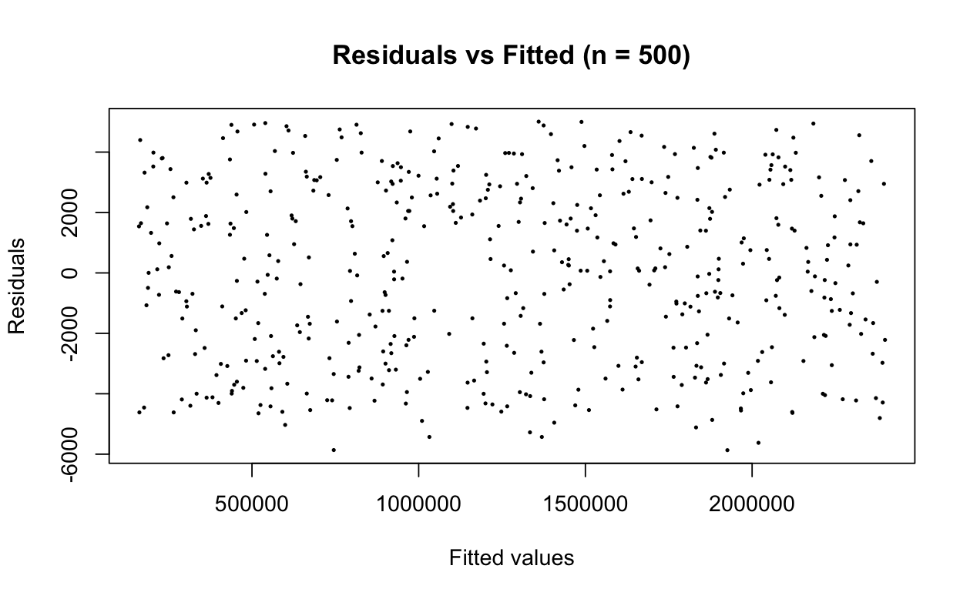
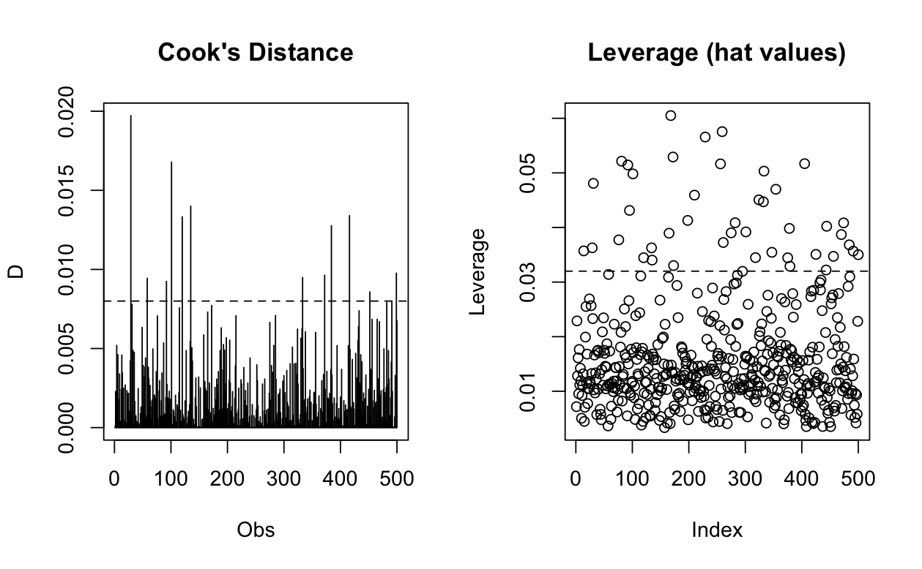
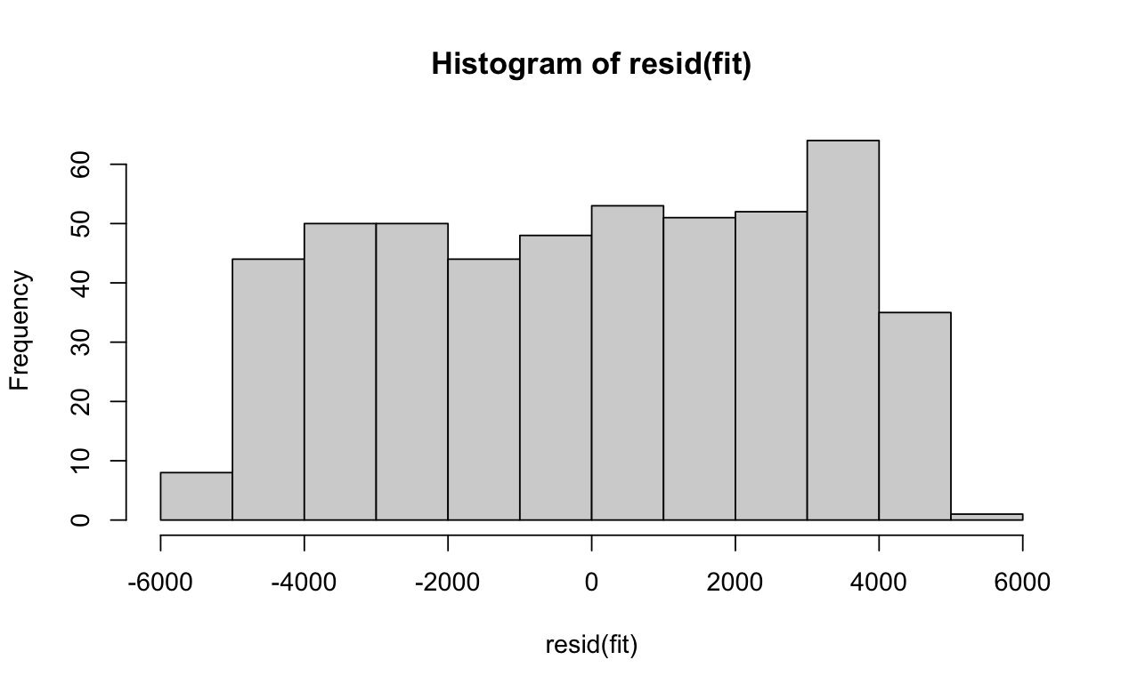
Methodology – elliott Shi
Initial Regression Model:
fit <- lm(price ~ factor(decision) * property_size_sqft + factor(decision) * constructed_year + factor(decision)*rooms, data=df_small)
No signs of non-linearity (residuals vs. fitted plot scattered, no pattern, and equal variance), multicollinearity (VIFs < 10), heteroskedasticity (BP p = 0.6512)
There were signs of
Non-normal errors (Non-normal histogram)
Large amounts of outliers

Slide 9
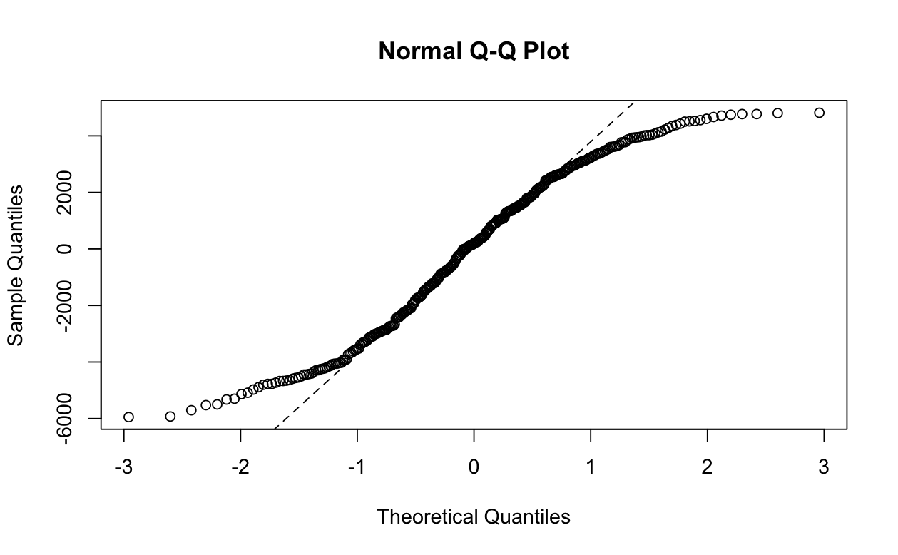
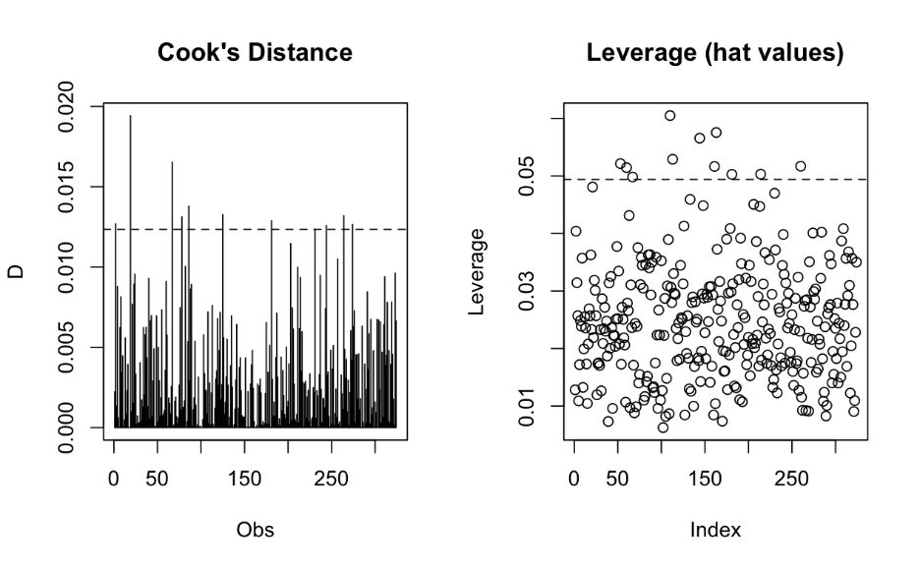
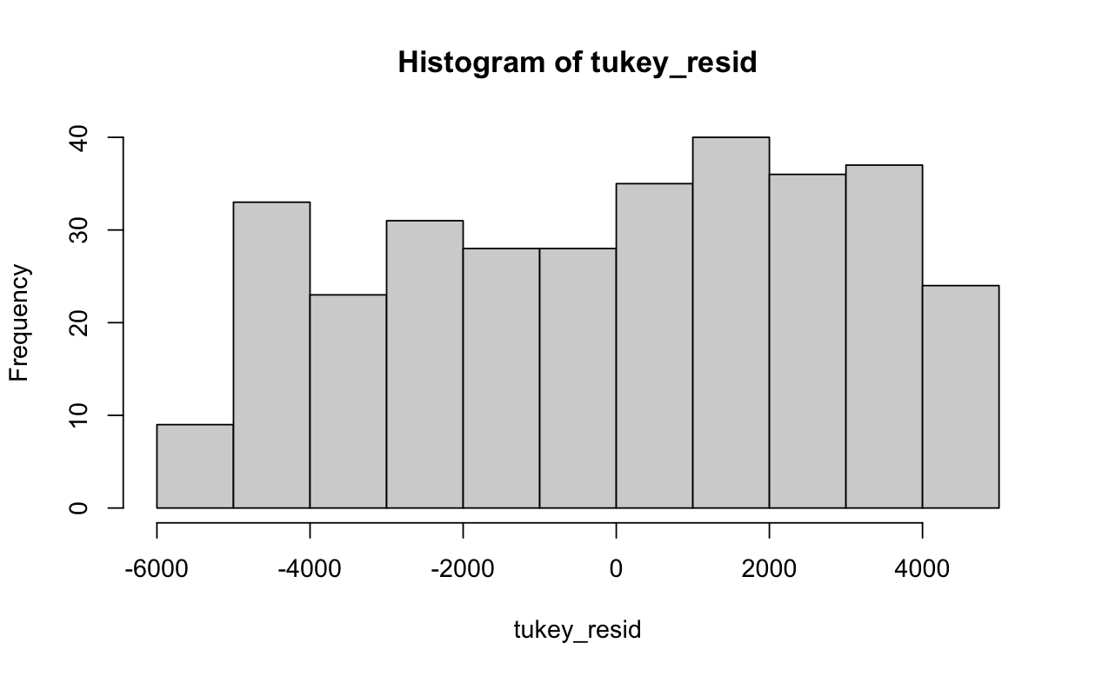
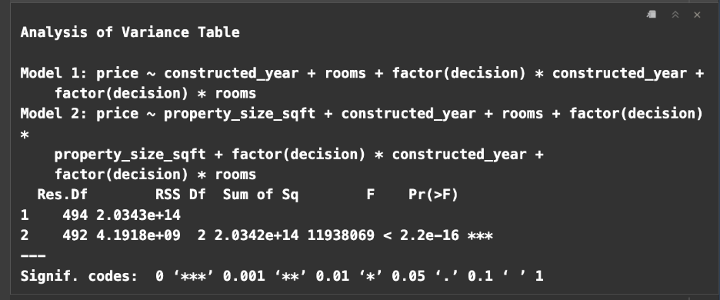
Results – ELliott Shi
Remedial Technique:
Outlier Removal
Robust Regression (only for interpretation)
Less outliers/influential points
QQplot slightly more normal
ANOVA output suggests that we reject null hypothesis at significance level .05.
Therefore, property size has a significant impact on housing price given number of rooms and constructed year

Slide 10
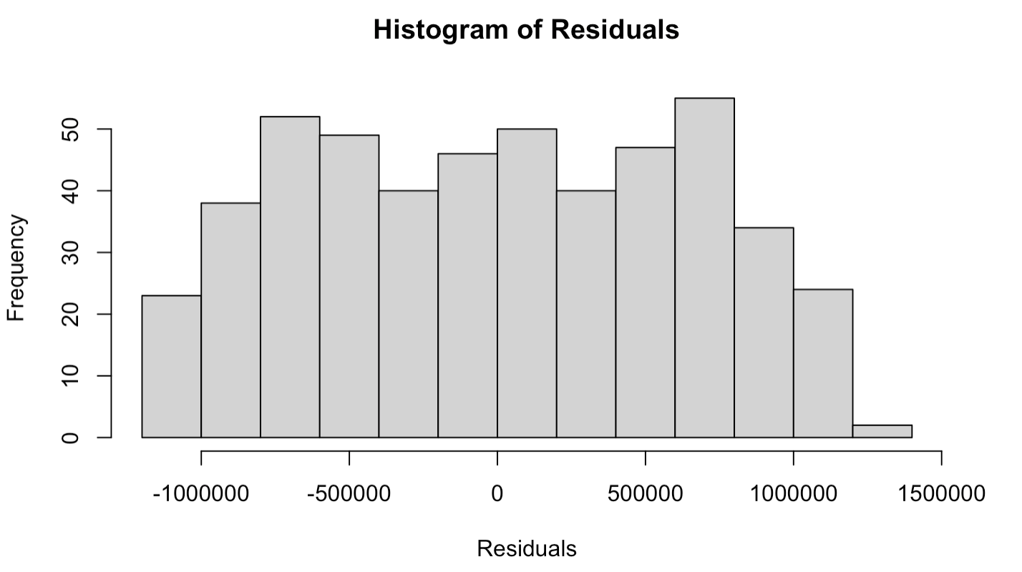
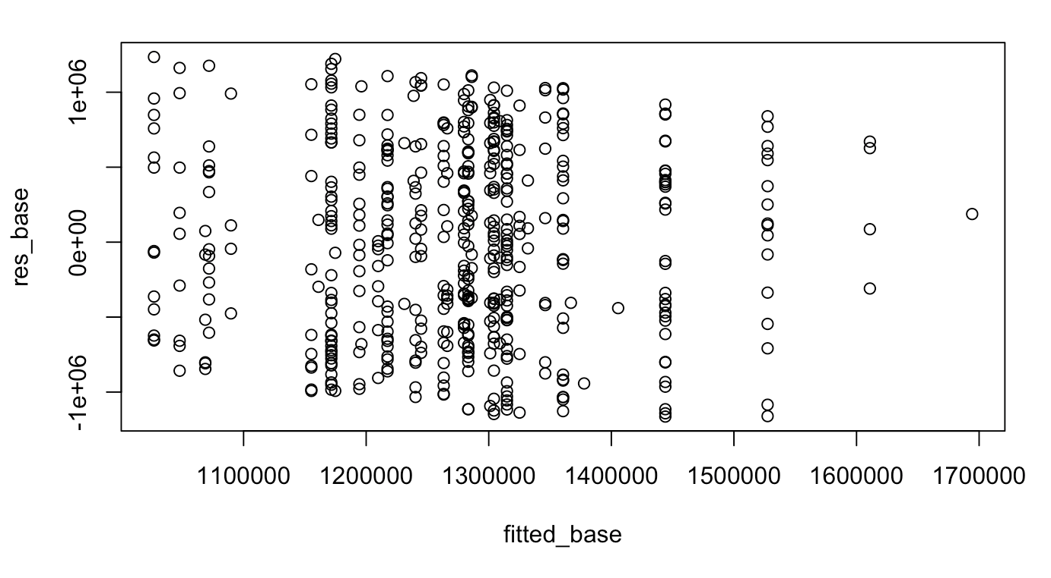
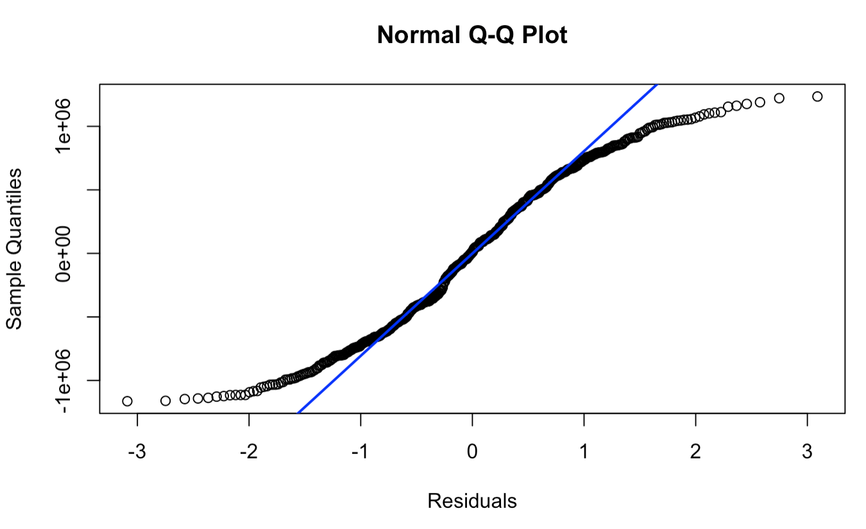
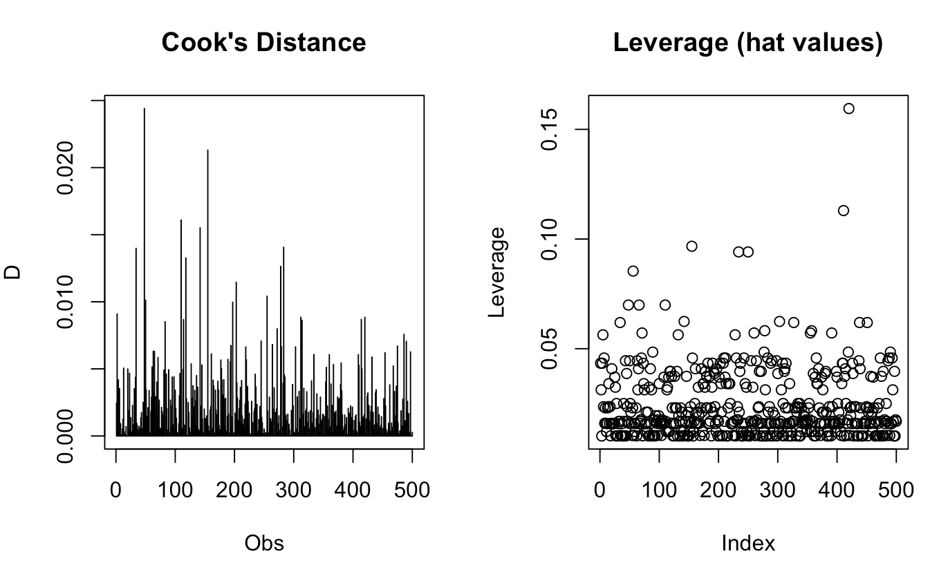
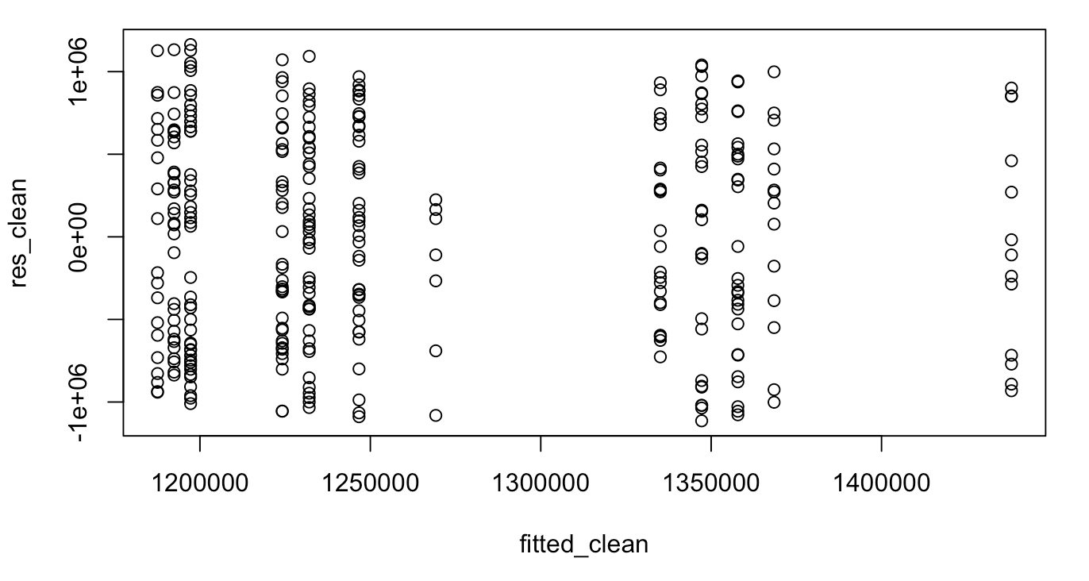
Methodology – Olivia Harper
Initial Model:
price ~ crime_cases_reported + legal_cases_on_property + crime_cases_reported*factor(city) + legal_cases_on_property*factor(city)
Diagnostics:
Linearity: no non-linearity
Normality: Shapiro p = 6.99 e-10 (normality issue)
Heteroscedasticity: BP test p = .8482 (constant variance)
Multicollinearity: all VIFs > 5 (multicollinearity issue)
Influential Points and Outliers:
Influential points were found
Applied IQR rule for outlier removal
IQR removed too many points
Notes:
For my model, my research hypothesis was oo location characteristics (crime rate and legal cases) and region impact house prices in the UK? So out of the available variable sin our dataset, there were only a few that could be related to location charactersitics. I looked at crime cases reported and legal cases on the property and then added city for my interaction effect which had four levels: Birmingham, Liverpool, London, and Manchester. After running the initial model, I got the top three plots. The residuals look somewhat normal, but we did get a Shapiro test with a p-value of 6.99 times 10-10 so very small indicating a normality issue. The QQplot shows decent deviation at both tails as well. Then on the top right we have the residuals vs. Fitted. It looks a little funky because although crime cases reported is technically continuous, it behaves more like a categorical variable since no more than 4 crime cases were ever reported. And the legal cases is a binary variable. From the plot, there is no curvature, potentially some non-constant variance, but the BP test did not have a significant P value, so maybe it is accounting for the categorical nature of the variables. And lastly for diagnostics I did a VIF test, and all the predictors came back with a VIF greater than 5 indicating multicollinearity, so we will need to address that later.
After that I did a test for influential points and outliers since we have non-normality and there looks like there could be outliers in the QQ plot. The cooks distance and leverage diagnostics did flag some influential points, so I decided to apply the IQR rule for outlier removal. However when I plotted the residuals again I got the graph in the bottom right. The outlier removal ended removing too many points, in fact it removed almost all of the points where legal cases = 1. So after considering the tradeoffs between removing them and keeping, I decided not to remove outliers to not skew the model too much and proceed with a weighted least square remedy.

Slide 11
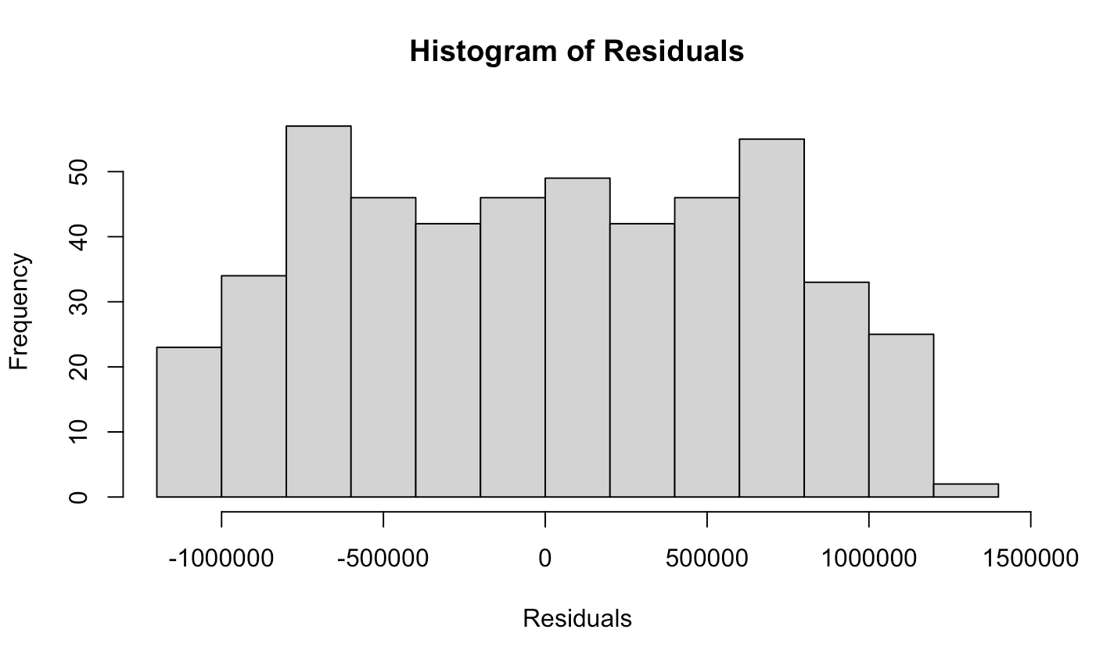
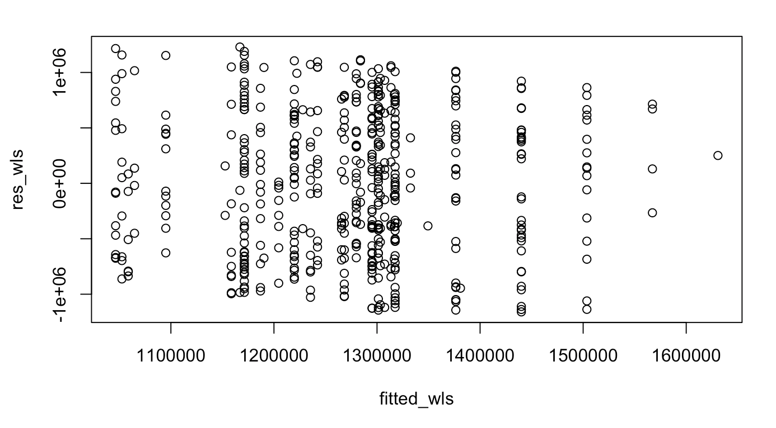
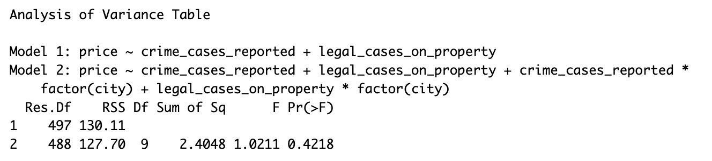
Results – Olivia Harper
Weighted Least Squares (normality): ​
Weights = 1/ fitted(ols)^2
Bootstrapped CI
  Intercept (1.158e+06, 1.564e+06)
​
Ridge Regression (multicollinearity): ​
Bootstrapped CI
  Intercept (1.213e+06, 1.326e+06)
Full Model:
price ~ crime_cases_reported + legal_cases_on_property + crime_cases_reported*factor(city) + legal_cases_on_property*factor(city)
Reduced Model:
price ~ crime_cases_reported + legal_cases_on_property + )
Anova output gives a p-value = 0.4218 suggesting that there are no overall regional effects
Notes:
So after doing the model diagnostics, I moved on to remedies before running the final anova test for the hypothesis. First to address the normality issue I did a weighted least squares which minimizes the sum of squared residuals by weighting each observation in the ols model. So after fitting a WLS model we got the following histogram and residual plot. They look pretty similar to the original model and had a very slightly larger p value, but it was practically negligible. However I decided to keep going a ran a bootstrapped confidence interval. The confidence intervals between the OLS bootstrapped values and the WLS bootstrapped values shift slightly downwards showing that there isn't a stronger positive effect of the WLS remedy. The only confidence interval that did not contain zero was the intercept. Since we get about the same results as what the summary of the initial model showed us, I'm not sure the WLS remedy improved much or there just isn't an overall effect.
Next to address multicollinearity I performed a ridge regression. The bootstrapped confidence intervals showed a similar but slightly smaller interval. Many of the confidence intervals overlap indicating that impacts many not be statistically significant. But to truly tell that: I ran an anova test with the full model including all predictors and the reduced model removing all city interactions. The output gives us a 0.4218 p-value suggesting that there are no overall regional effects and corroborating some of the results seen earlier.

Slide 12
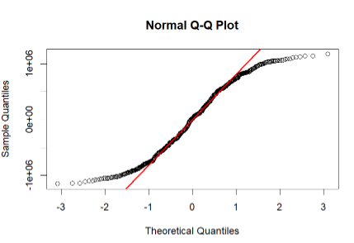
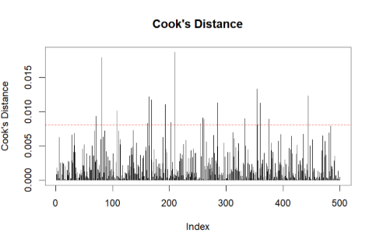
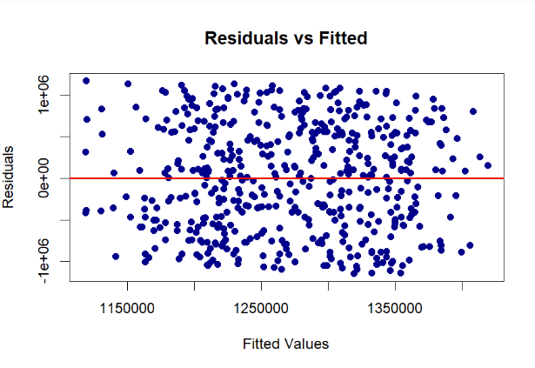
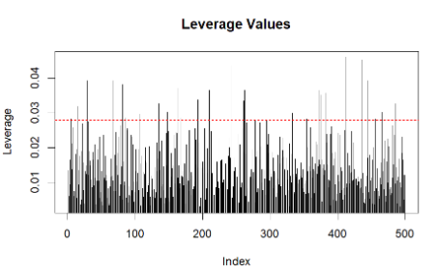
Methodology – Lyndsey Harris
Initial Regression Model:​
model_full <- lm(price ~ satisfaction_score + neighbourhood_rating + connectivity_score + decision + connectivity_score * neighbourhood_rating + connectivity_score * decision,
data = df_small)
There were signs of​
Large amounts of outliers​
Non-normal residuals
Potential influential points
​
​

Slide 13
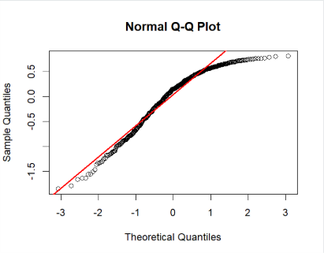
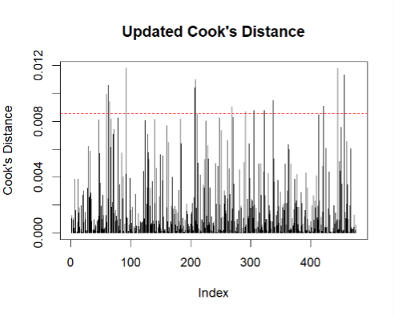
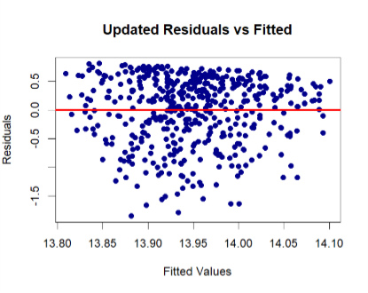
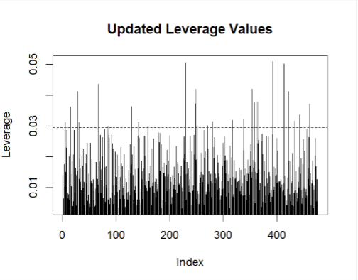
Results – Lyndsey Harris
Log Transformation Applied
House price log-transformed to address non-normality and heteroscedasticity.
Model re-fitted after transformation.
Final Model Diagnostics
Residuals vs Fitted: Residuals evenly scattered → improved linearity and homoscedasticity.
Normal Q-Q: Closer to diagonal → improved normality
Cook’s Distance: No extreme influential points after removal; all below cutoff.
Leverage Values: Most observations low leverage; none exceed the threshold.

Slide 14
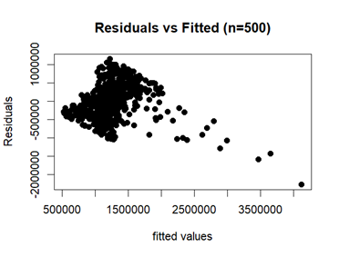
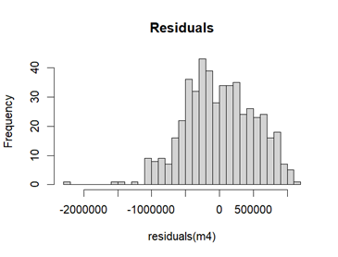
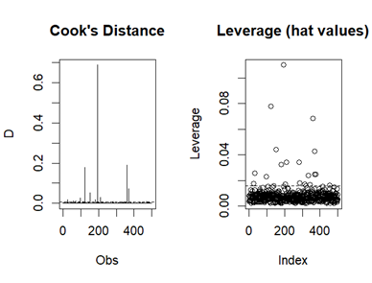
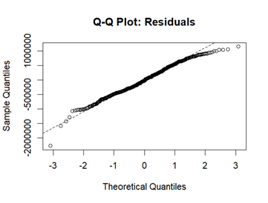
Methodology – Rahmi azzahra
Model:
Full model <-lm(price ~ customer_salary + monthly_expenses + emi_to_income_ratio, data = df_small)
Diagnostics:
Linearity: non-linearity
Normality: Shapiro-Wilk
p = 0.0003968<0.05 (not normally distributed)
Heteroscedasticity: Breusch-Pagan test
p = 110.63 (suffer from heteroscedasticity)
Multicollineary: all VIFs > 5 (multicollinearity issue)
Influential Points and Outliers:
Very influential observations (Cook’s D ≈ 0.6).
Outliers exist
Remedial techniques:
Log Y transform, and Robust Regression

Slide 15
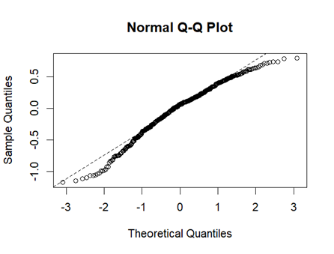
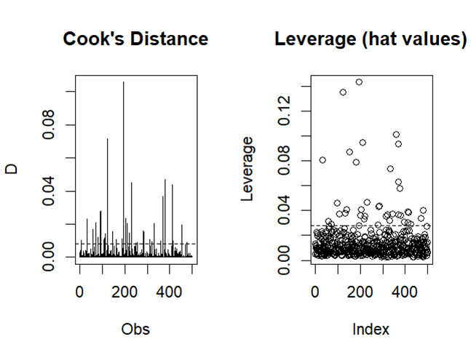
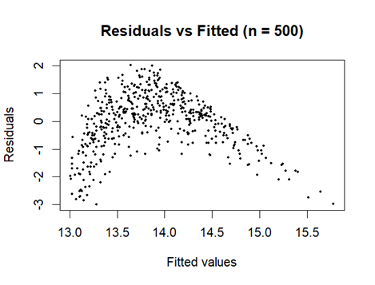
Results – Rahmi azzahra
After log-transformation:
Shapiro–Wilk: still non-normal → rely on robust regression
Residuals vs Fitted: more uniform spread
Robust Regression:
Residual standard error: 0.373 (log scale)
Residuals range: –1.23 to 0.76
BP test: improved → variance much closer to constant on log scale.
Downweights extreme observations: more stable estimates.
Significant Predictors.
Salary (c_salary): Strong positive effect.
EMI ratio (c_emi): Large positive effect.
Salary × EMI interaction: Highly significant.
Monthly expenses and related interactions: Not significant.

Slide 16
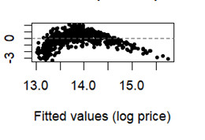
Results – Rahmi azzahra
Robust Regression (Hubert) Figure: Residuals vs. Fitted Values on LogY
Predictor | Log OLS (Robust SE) | Robust (Huber)
Intercept | 14.244 | 14.258
Salary (c_salary) | 2.36e-05 | ~0.000
EMI ratio (c_emi) | 8.04 | 7.83
Expenses (c_expenses) | 1.90e-06 | ~0.000
Salary x EMI | 1.43e-04 | ~0.000
Robust standardized residuals

Slide 17
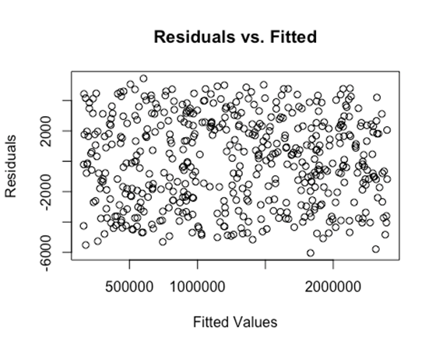
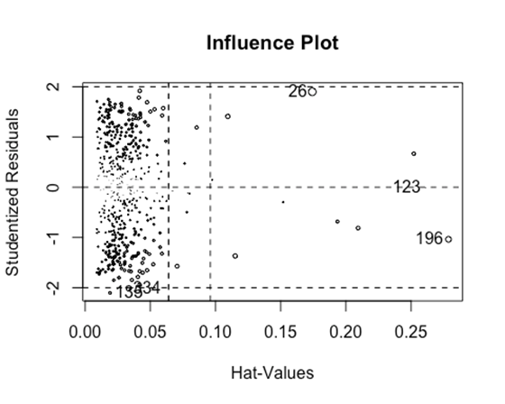
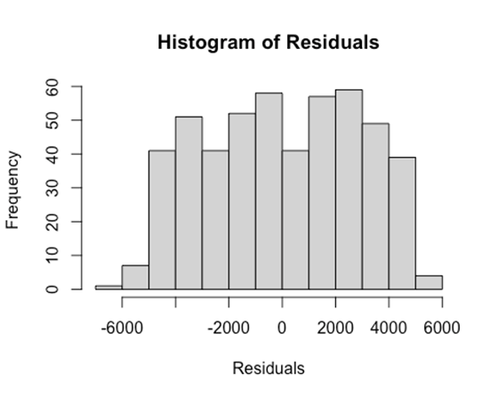
Methodology – Full model
Initial Regression Model: (based on model selection criteria)
Model <- lm(price ~ property_size_sqft + satisfaction_score + emi_to_income_ratio +
property_size_sqft*factor(city) + satisfaction_score*factor(city) +
emi_to_income_ratio*factor(city), data = df)
No signs of non-linearity (residuals vs. fitted plot has no pattern or curve)
heteroskedasticity (BP p = 0.9386)
There were signs of
Non-normal errors (non-normal histogram)
Multicollinearity (VIF >10)
Small amounts of outliers present

Slide 18
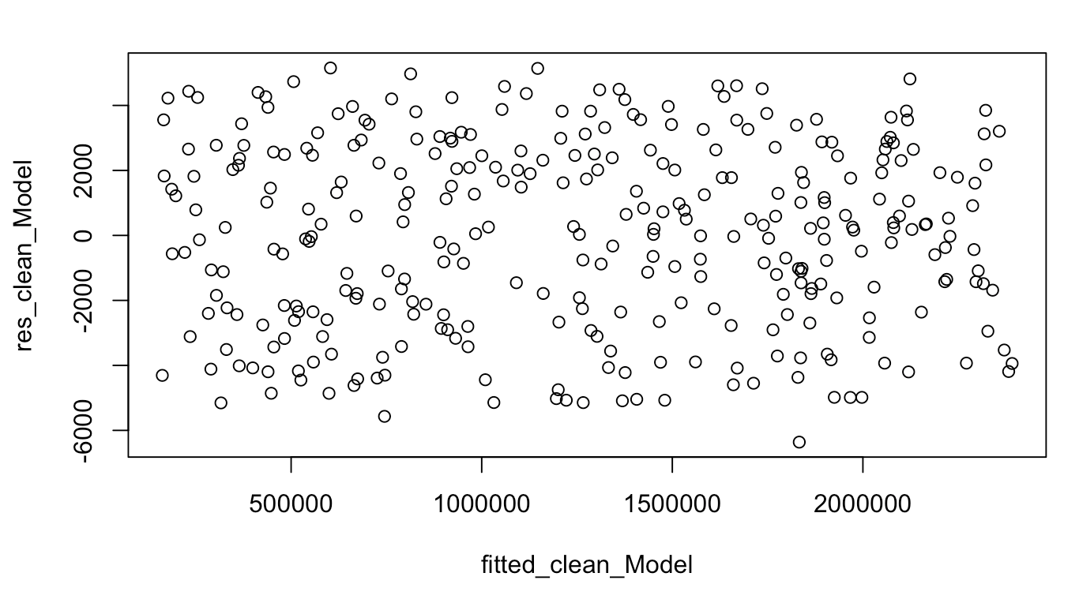
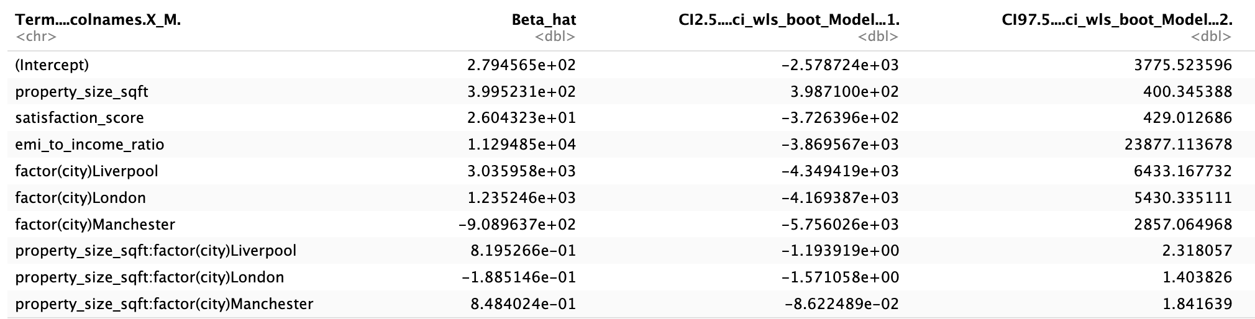
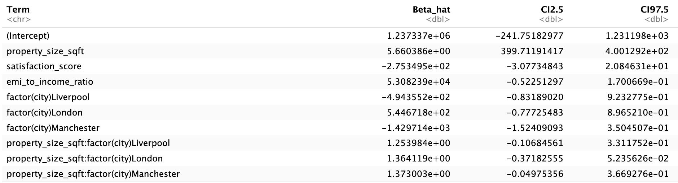
Results – Full model
Cleaned Model:
Shapiro Wilk- 4.152e-07 (still significant, but larger than the original model)
BP Test – 0.3803 (not significant)
VIF – all values >8
Weighted Least Squares: (Normality)
WLS Shapiro-Wilk: 0.000135
Bootstrapped CI
  Property Size (398.71, 400.35)
  EMI Ratio:Manchester (-3.816e+04, -1828.79)
Ridge Regression: (Multicollinearity)
Bootstrapped CI
  Property Size (399.71, 400.13)
WLS Bootstrapped Confidence Intervals
Ridge Regression Bootstrapped Confidence Intervals
Notes:
Following Elliott's diagnostics that there are some influential points and potential outliers, we did create a new dataset with removed outliers according to the IQR rule. After re-running the model with the cleaned daset
For ridge regression interpretation according what was said in lecture, if the goal is prediction, which is our goal, we should retain predictors even if confidence intervals overlap or there is high correlation. Thus even though we get some highly correlated intervals , since we want to predict we will continue to the anova model only using the weighted least squares model.

Slide 19
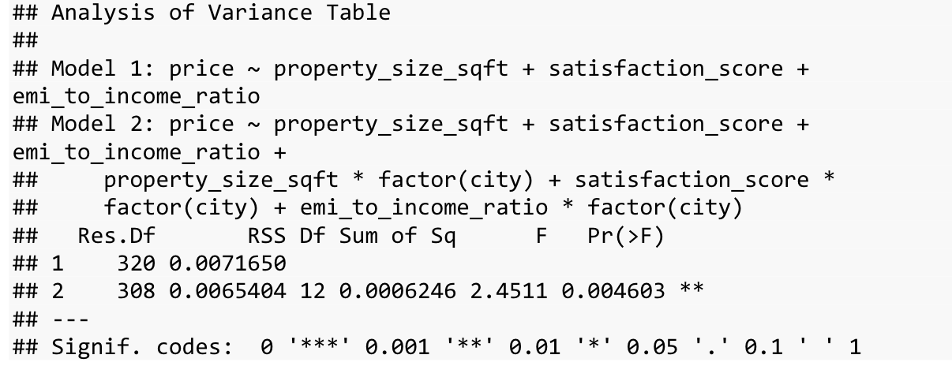
Discussion
Our ANOVA produces a significant F statistic.
Therefore we reject the null hypothesis and conclude that this study provides evidence at the .05 significance level that the relationship between price and one or more predictors depends on city.
While intuitive at first, we learned that city does play a significant role in determining the price of property in the UK.
Diagnostics served an important role in determining model choice.

Slide 20
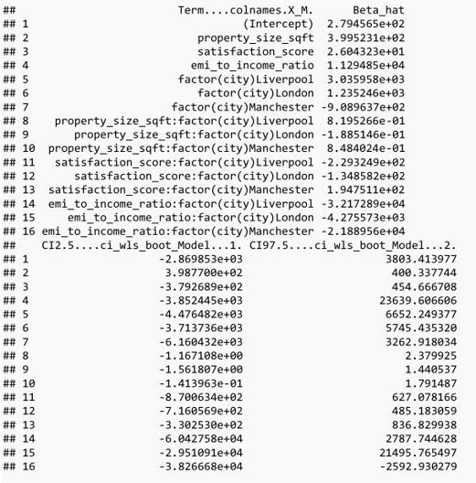
discussion
With WLS and bootstrapping, we get the following coefficient estimates.
The final model tells us that homes in the UK heavily depend on city.
One limitation of this project is that we weren't able to comprehensively consider every potential variable due to time constraints

